Slide 1

ReactJS
Amarjeet Singh (Technical Architect)

Slide 2
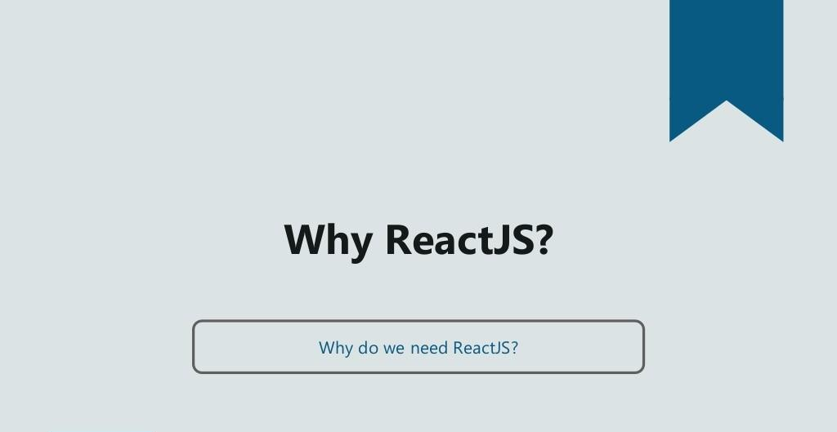

Slide 3
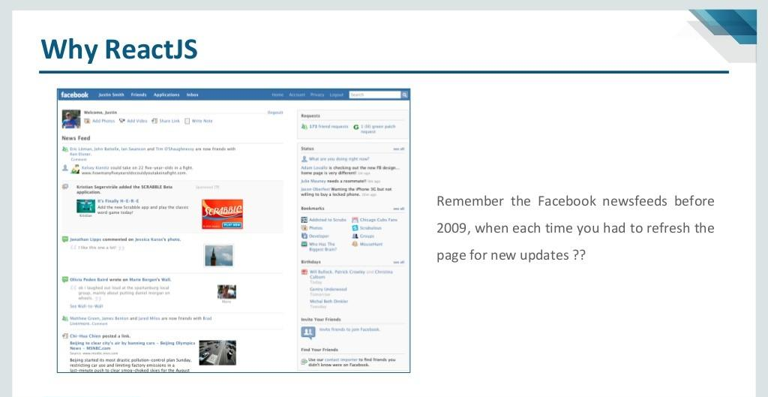

Slide 4
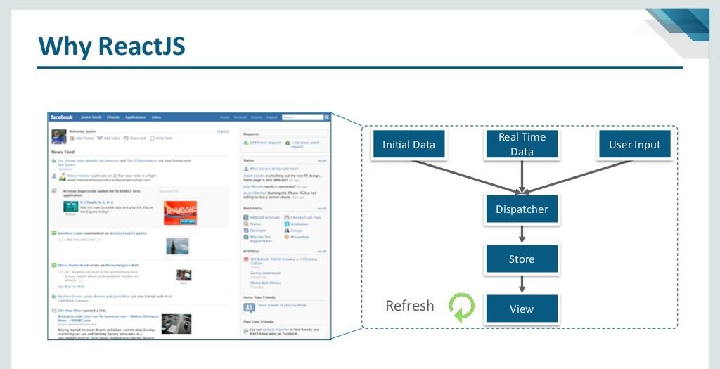

Slide 5
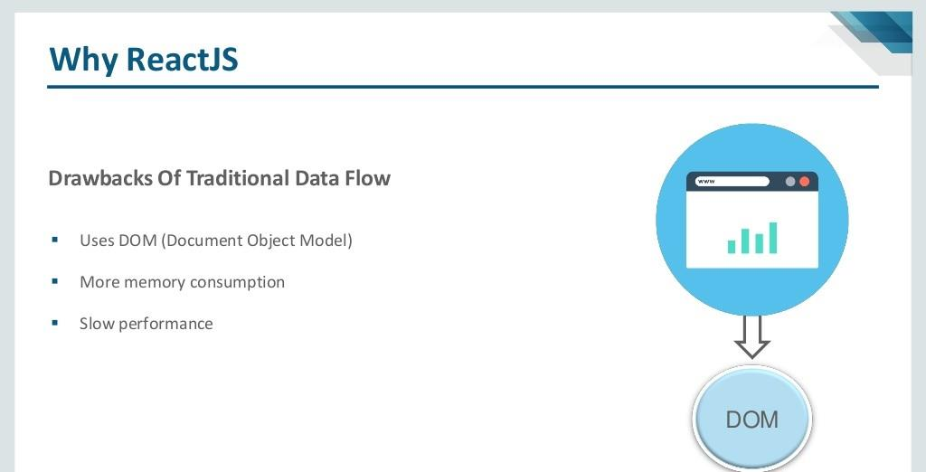

Slide 6
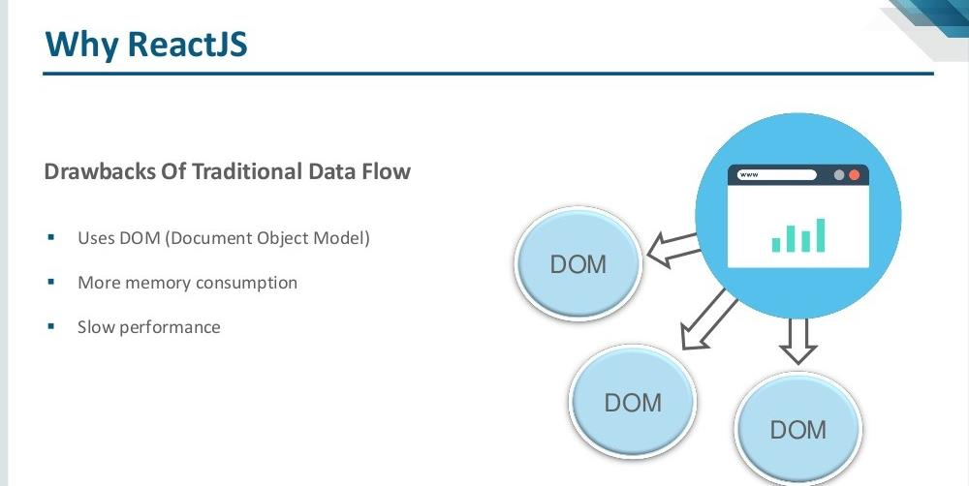

Slide 7
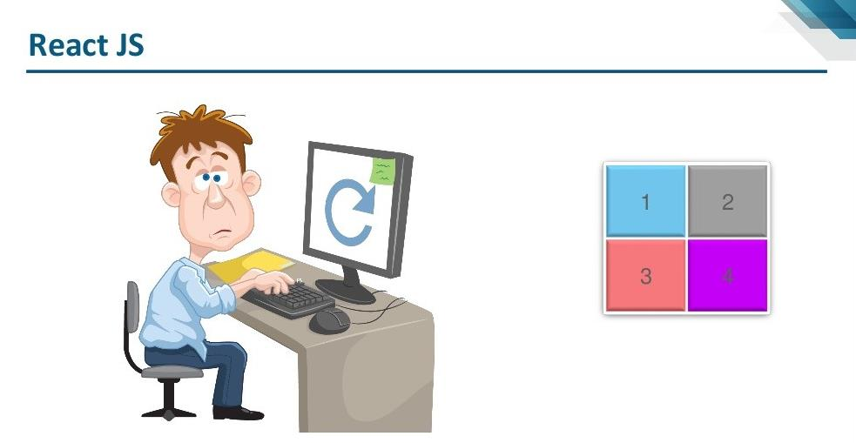

Slide 8
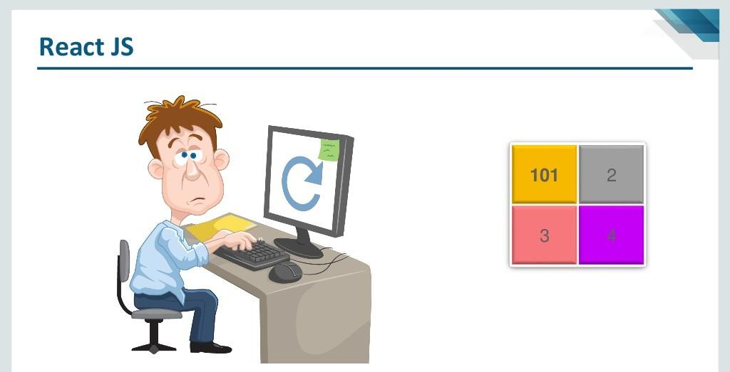

Slide 9
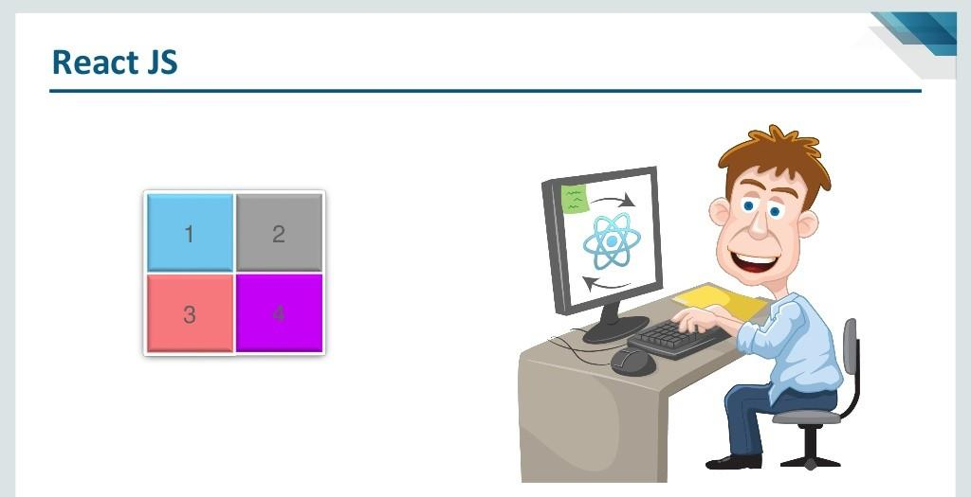

Slide 10
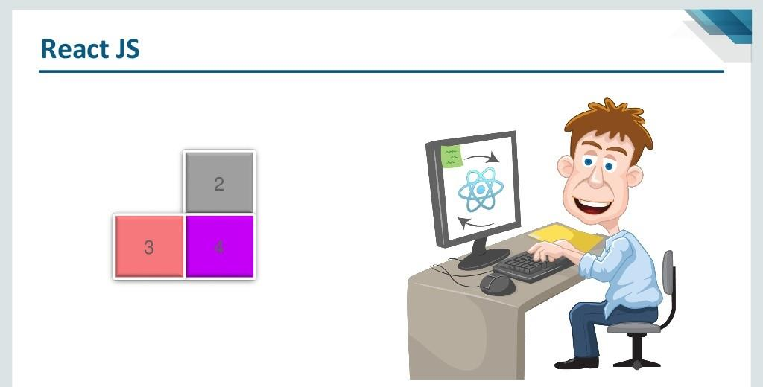

Slide 11
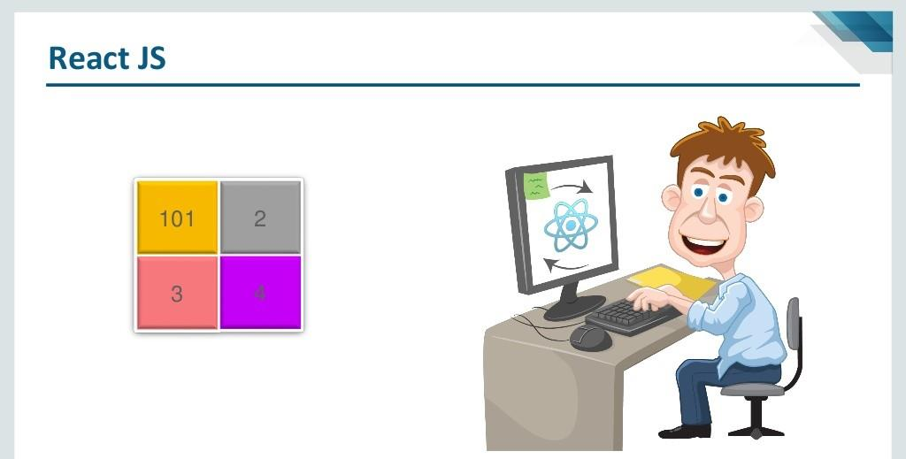

Slide 12
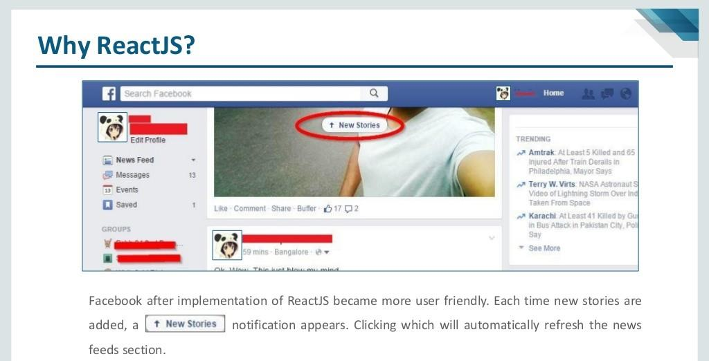

Slide 13
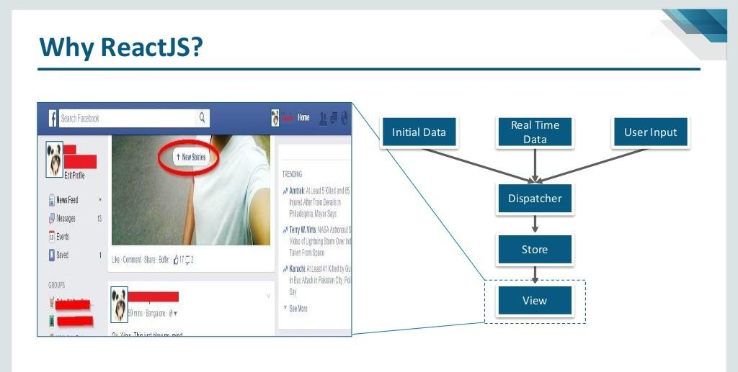

Slide 14
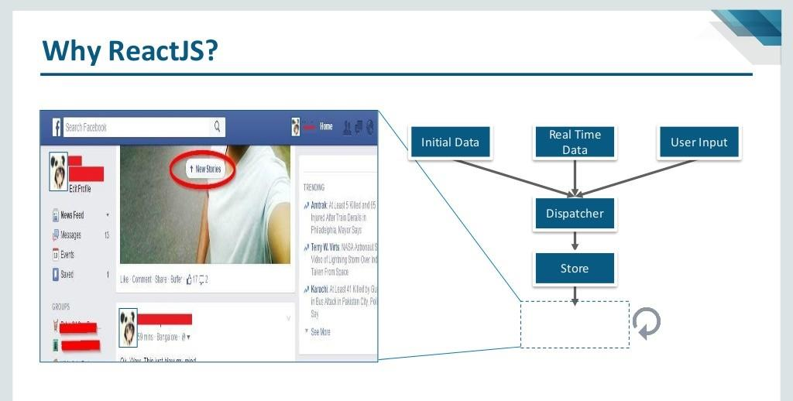

Slide 15
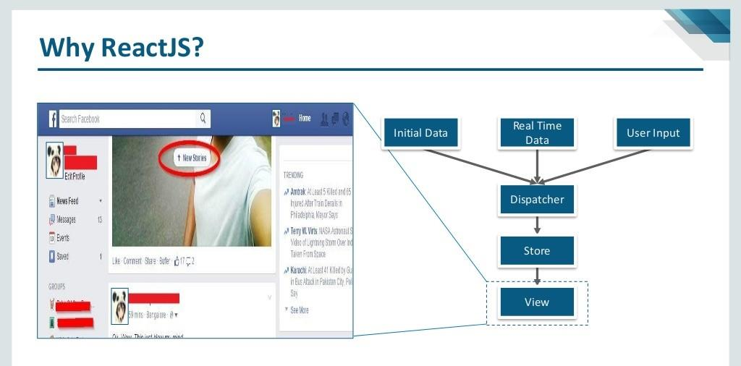

Slide 16
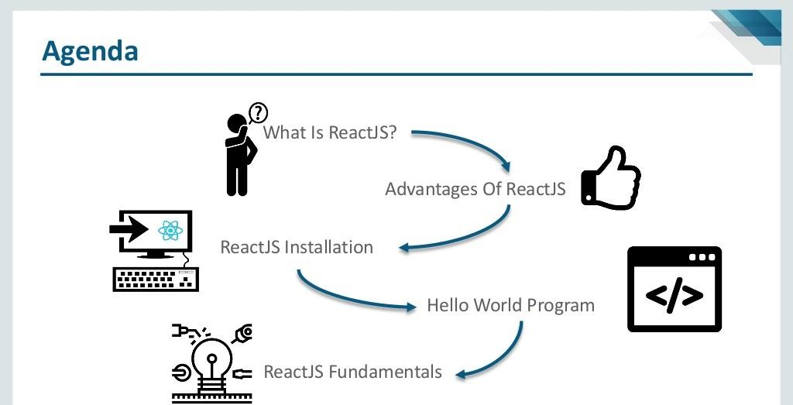

Slide 17
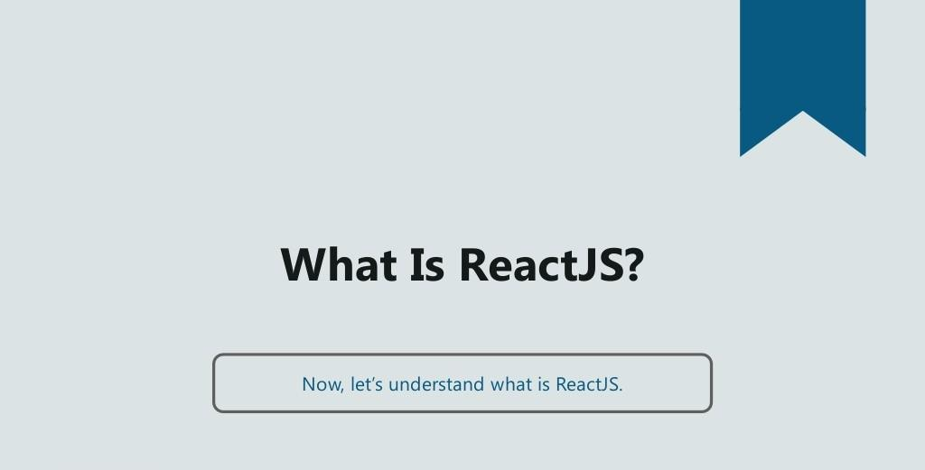

Slide 18
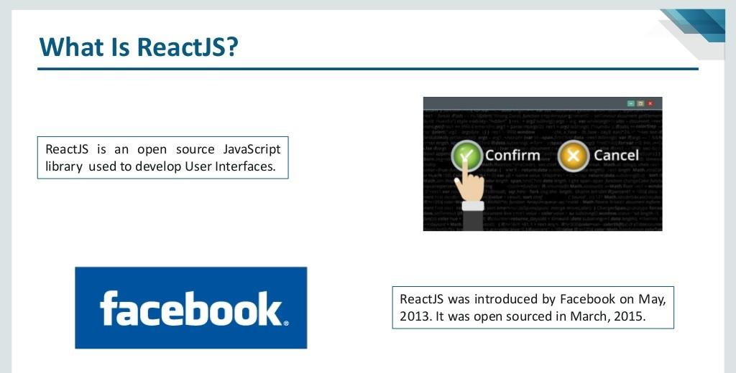

Slide 19
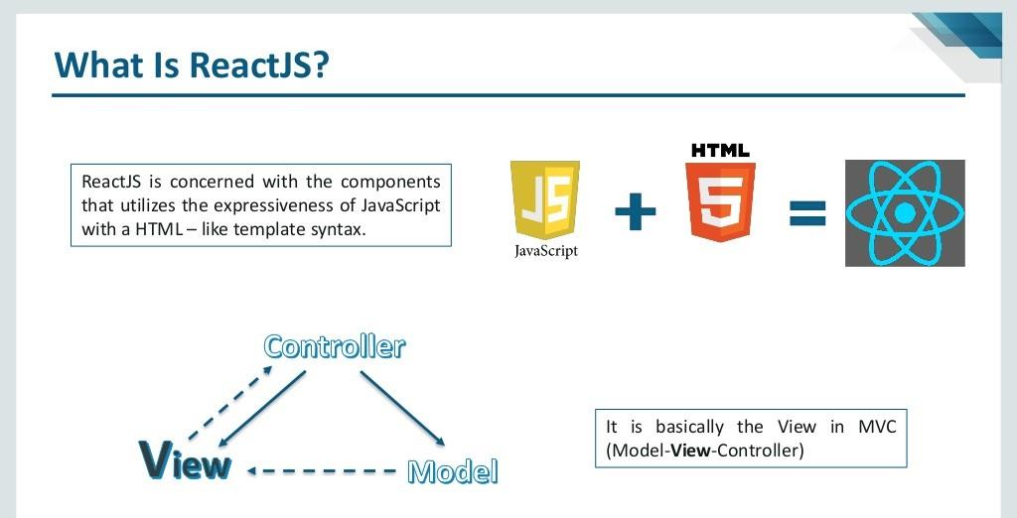

Slide 20
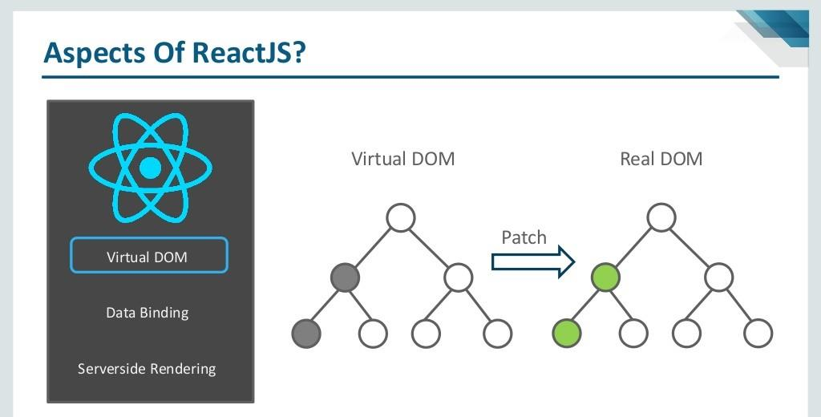

Slide 21
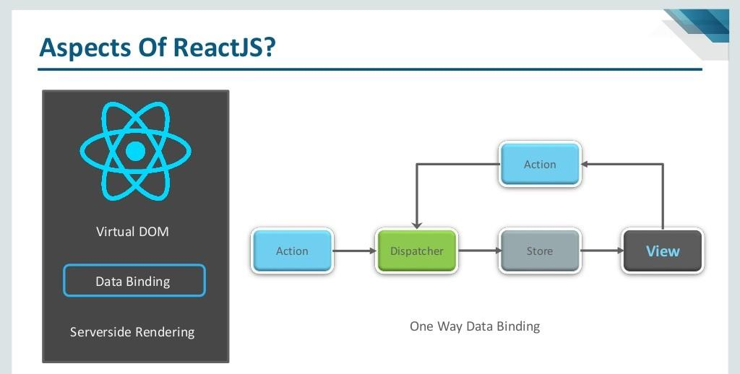

Slide 22
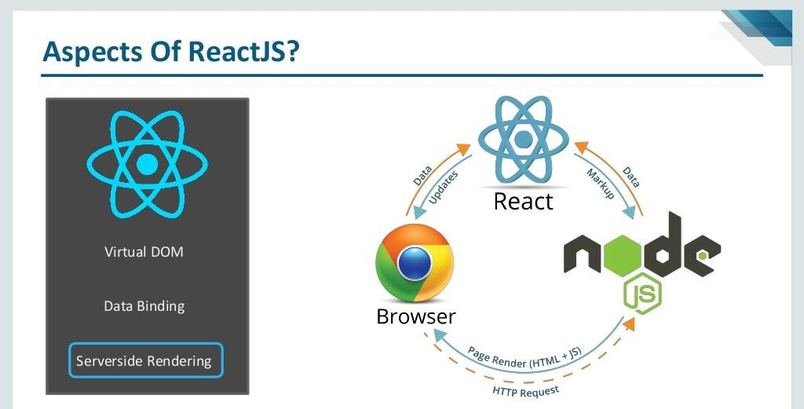

Slide 23
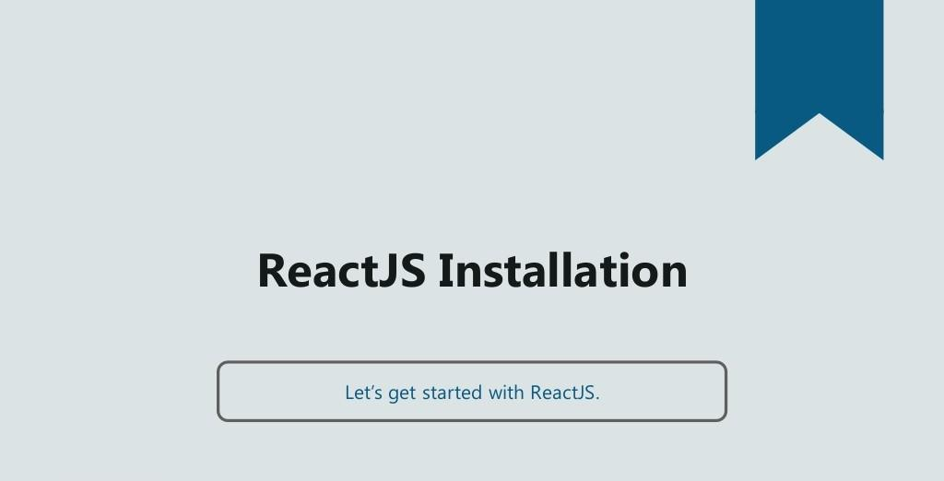

Slide 24
ReactJS Software Requirement
VS Code Editor
NodeJS ver 6.0 or above

Slide 25
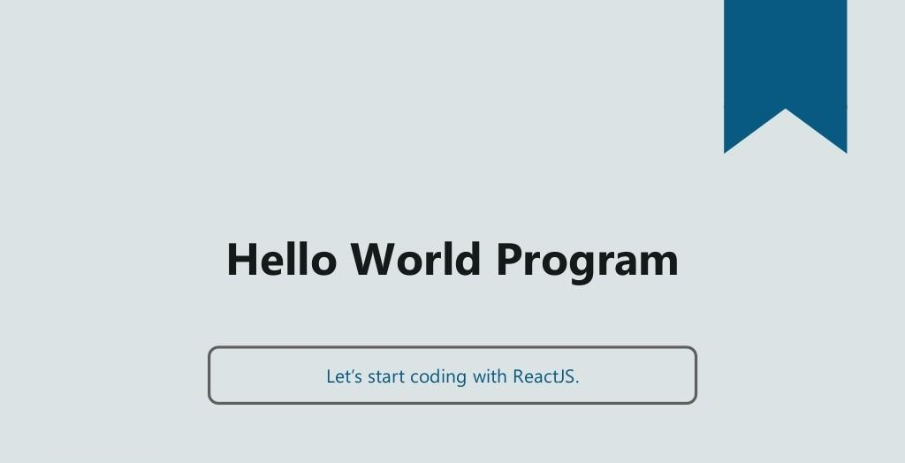

Slide 26
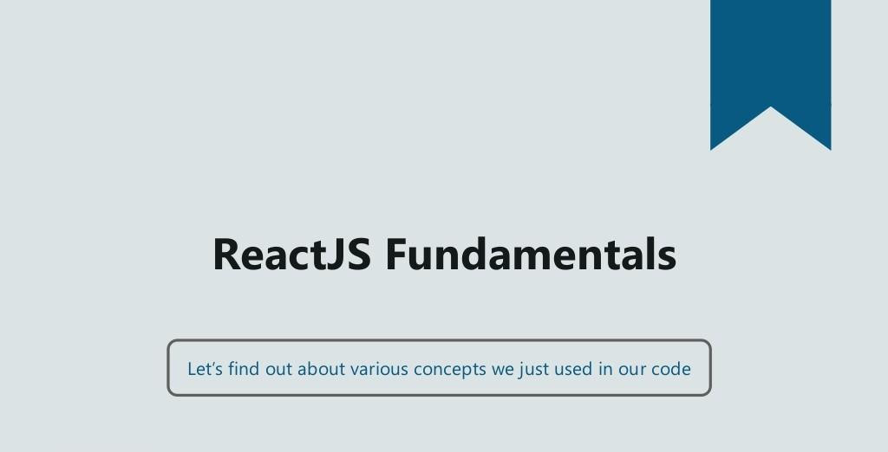

Slide 27
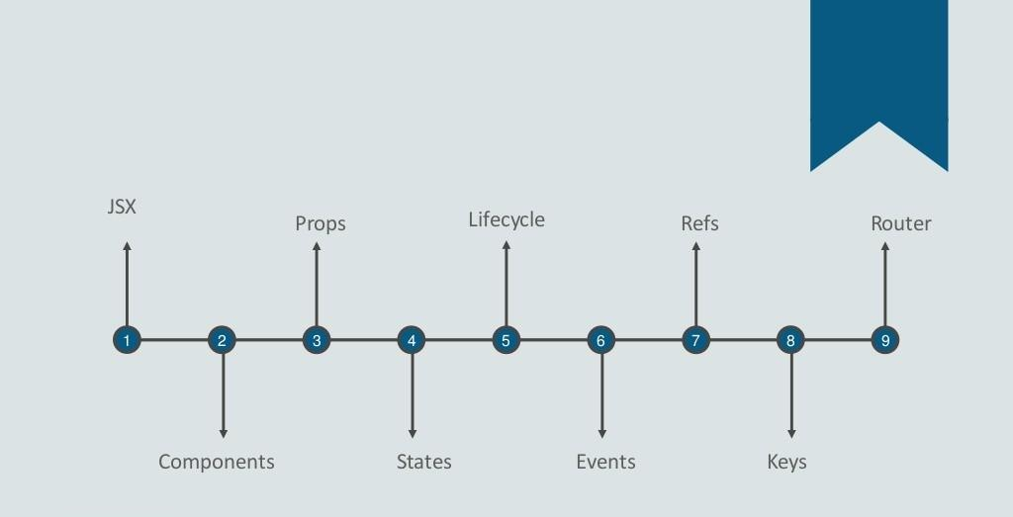

Slide 28
ES5 VS ES6 VS JSX
ES5 (the ES stands for ECMAScript) is basically "regular JavaScript." The 5th update to JavaScript, ES5 was finalized in 2009. It has been supported by all major browsers for several years. Therefore, if you've written or seen any JavaScript in the recent past, chances are it was ES5.
ES6 is a new version of JavaScript that adds some nice syntactical and functional additions. It was finalized in 2015. ES6 is almost fully supported by all major browsers.
But it will be some time until older versions of web browsers are phased out of use. For instance, Internet Explorer 11 does not support ES6, but has about 12% of the browser market share.
JSX is a pre-processor step that adds XML syntax to JavaScript. You can definitely use React without JSX but JSX makes React a lot more elegant.
Just like XML, JSX tags have a tag name, attributes, and children. If an attribute value is enclosed in quotes, the value is a string. Otherwise, wrap the value in braces and the value is the enclosed JavaScript expression.

Slide 29
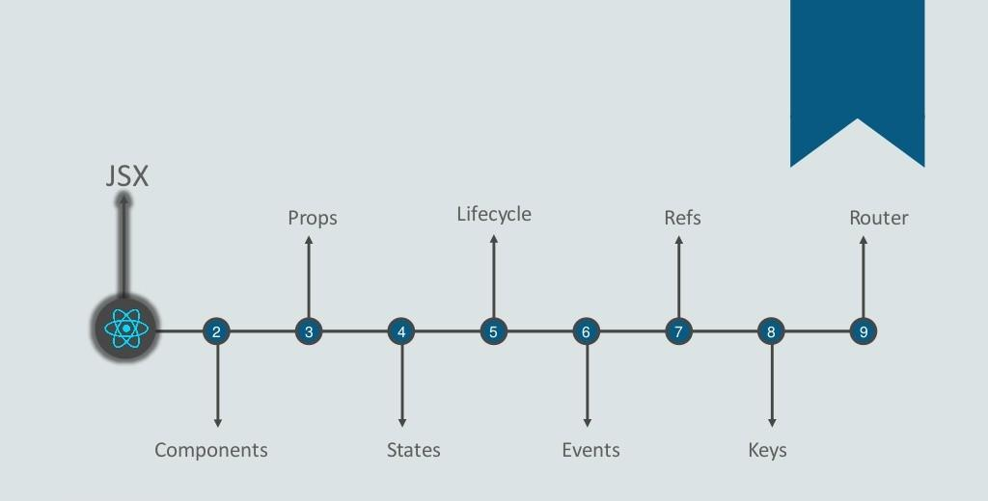

Slide 30
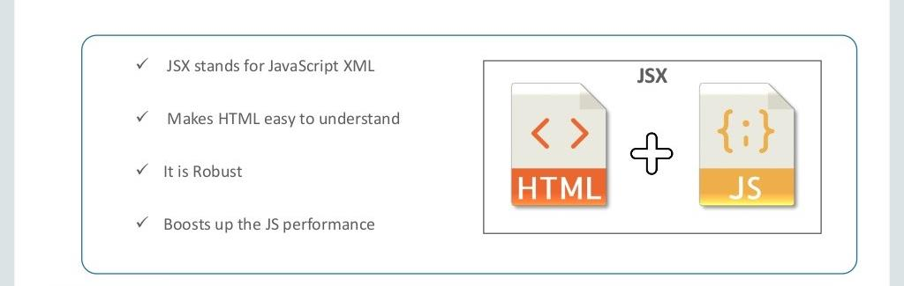

Slide 31
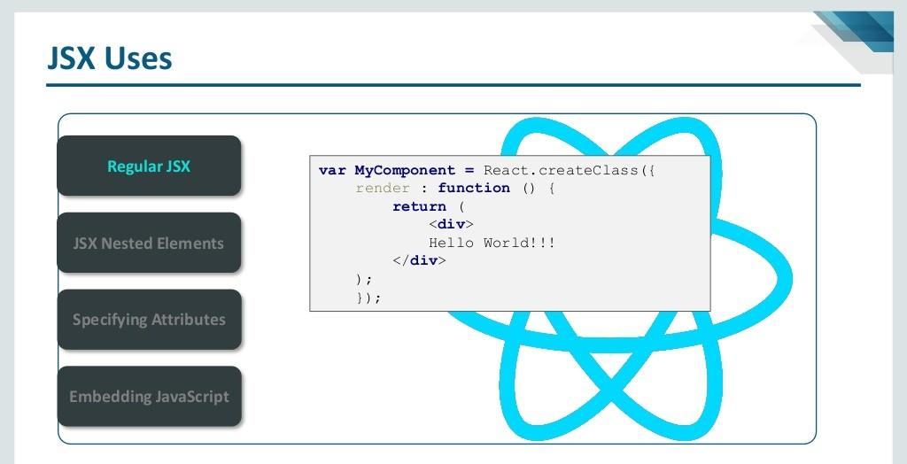

Slide 32
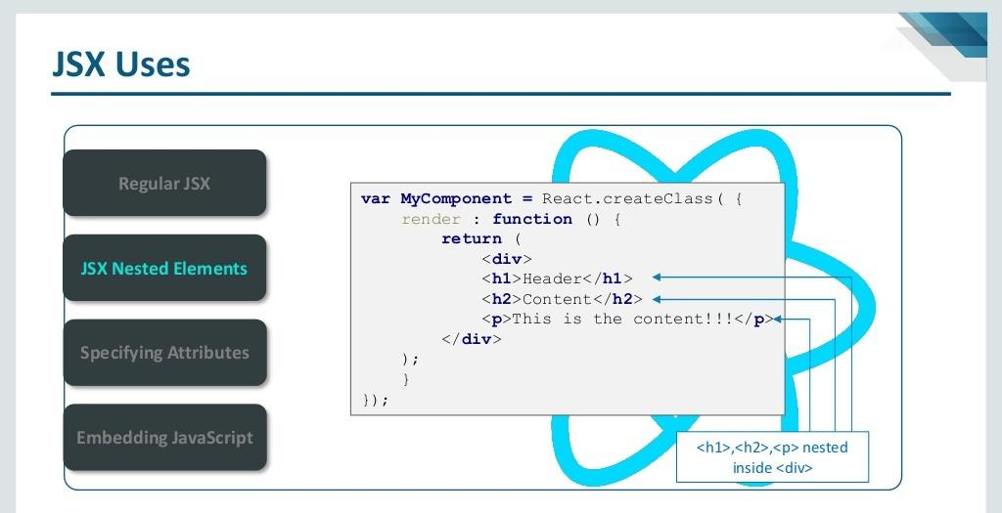

Slide 33
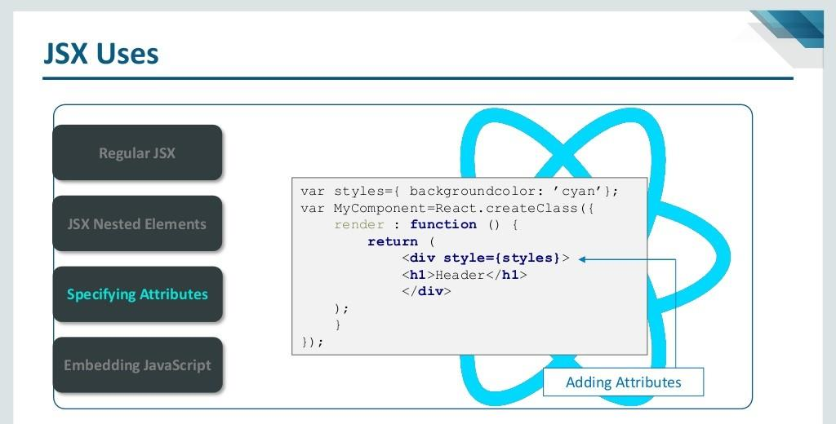

Slide 34
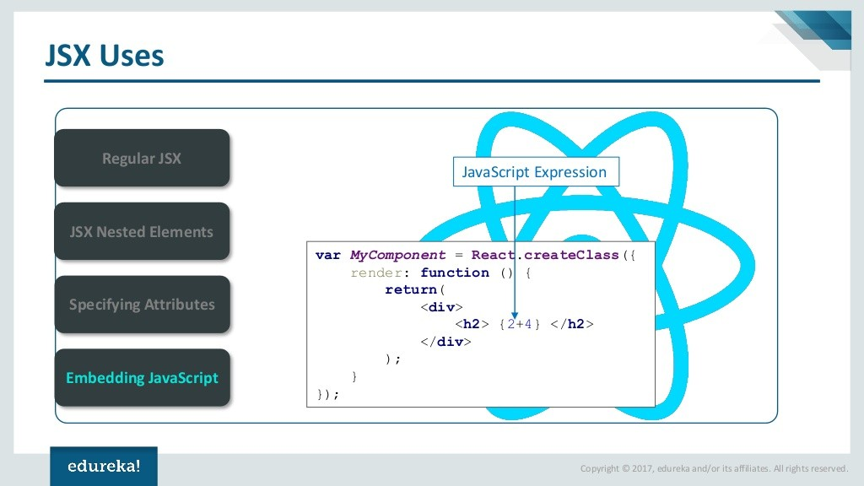

Slide 35
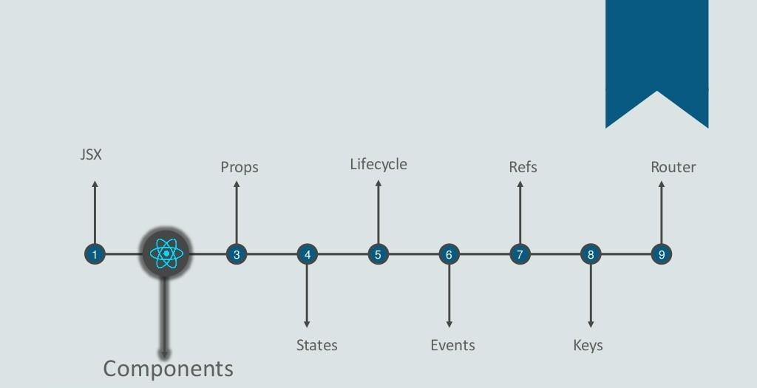

Slide 36
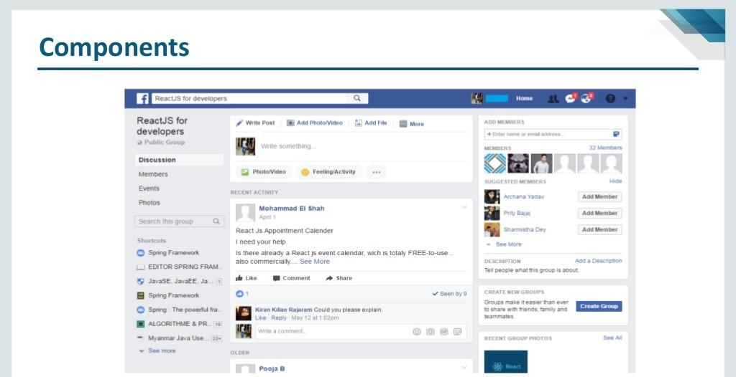

Slide 37
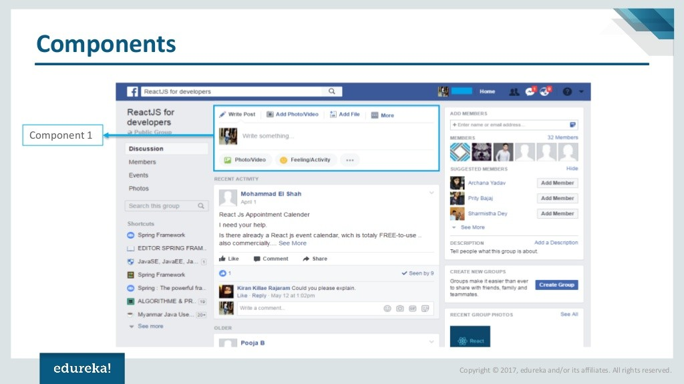

Slide 38
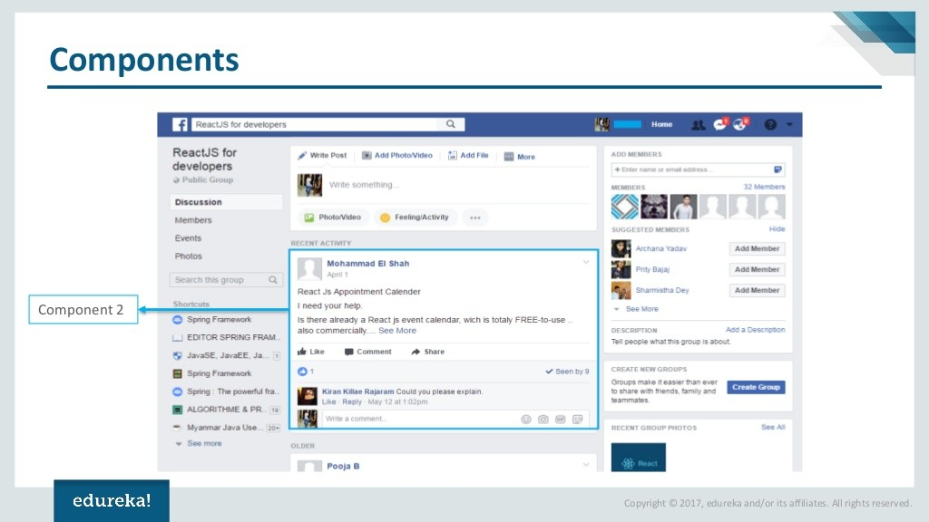

Slide 39
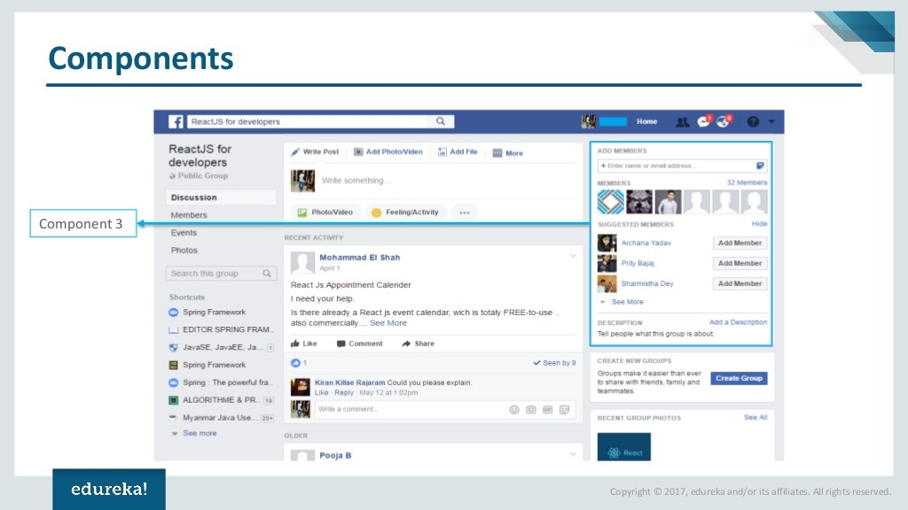

Slide 40
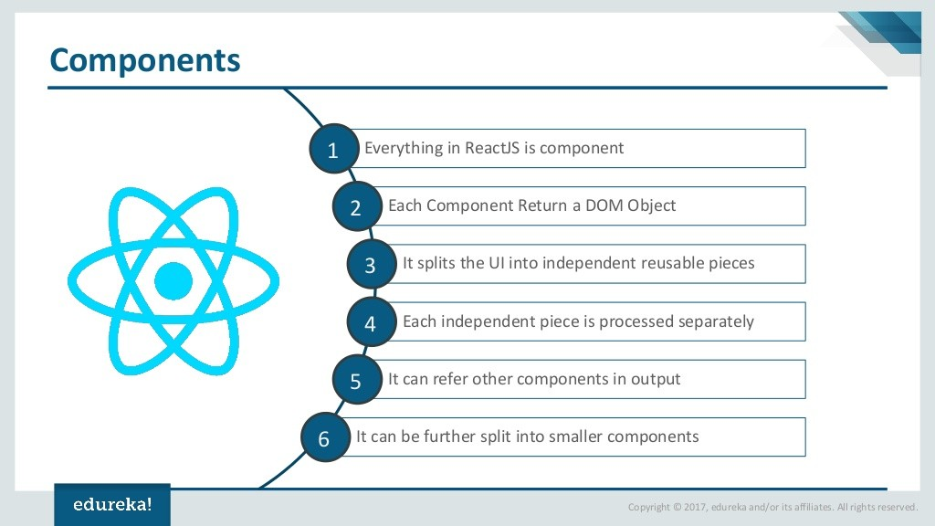

Slide 41
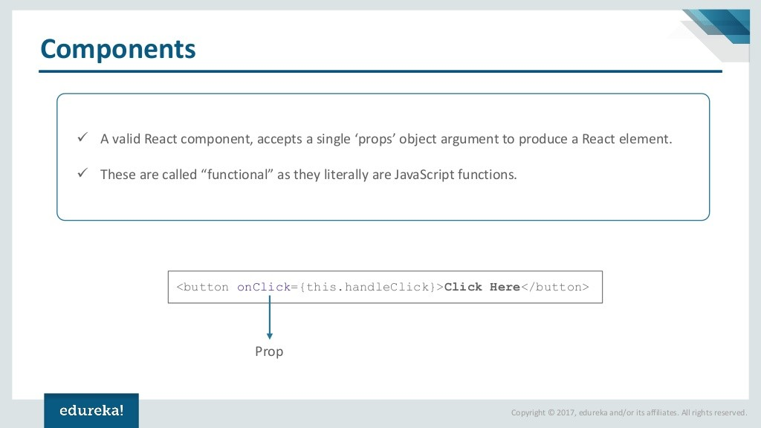

Slide 42
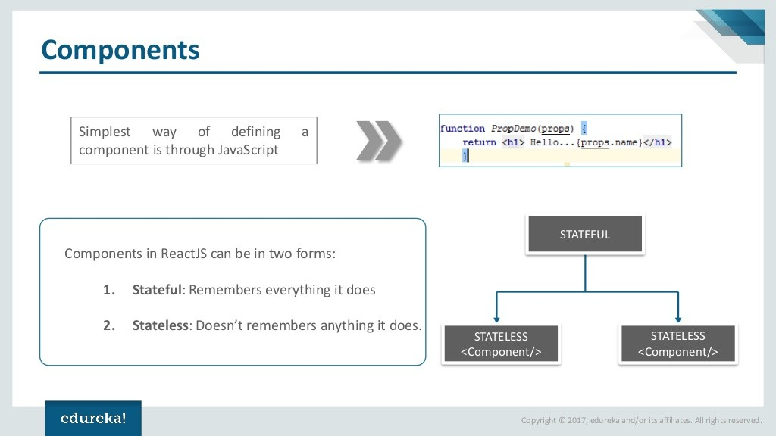

Slide 43
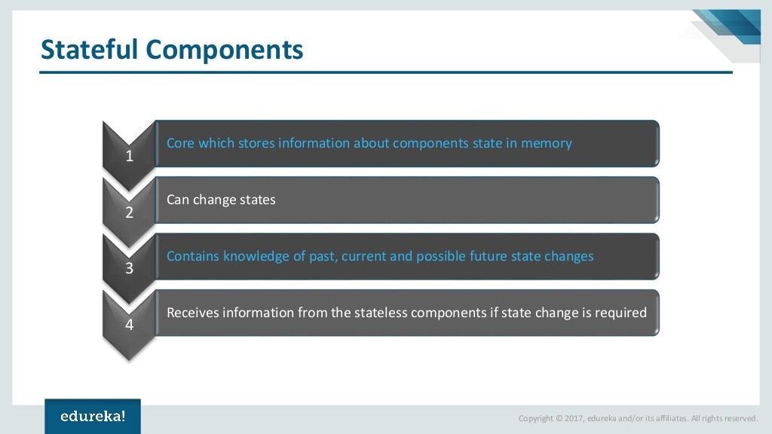

Slide 44
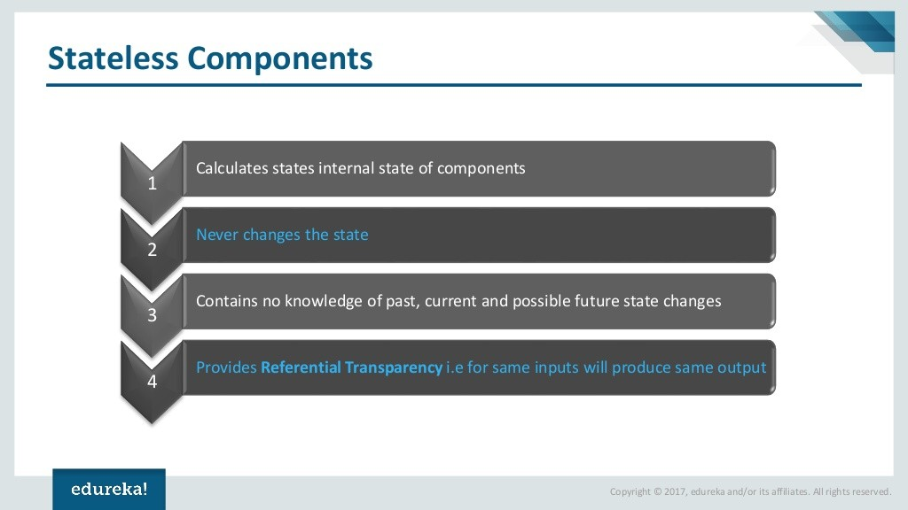

Slide 45
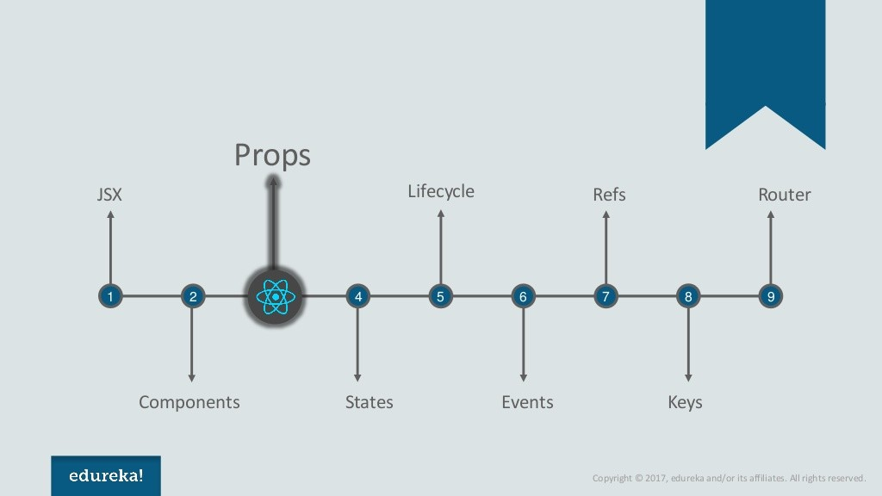

Slide 46
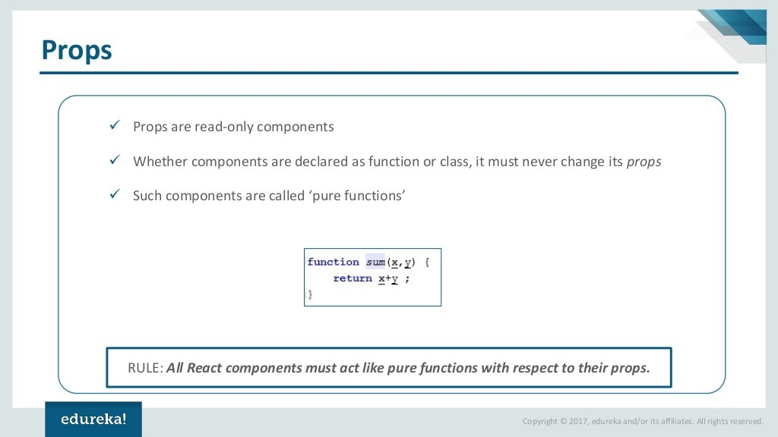

Slide 47
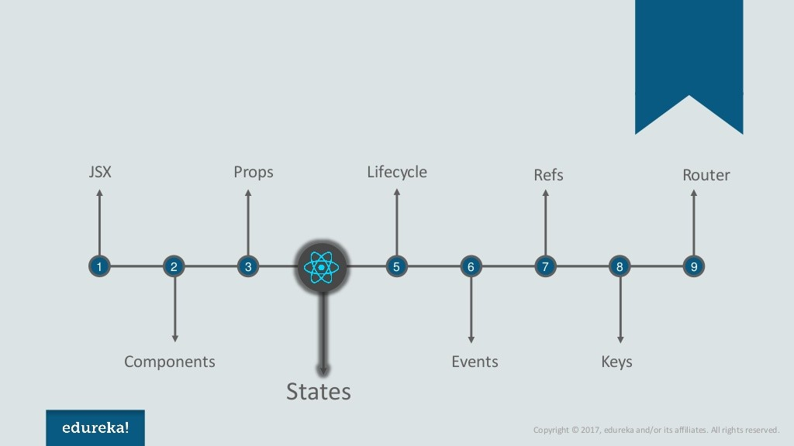

Slide 48
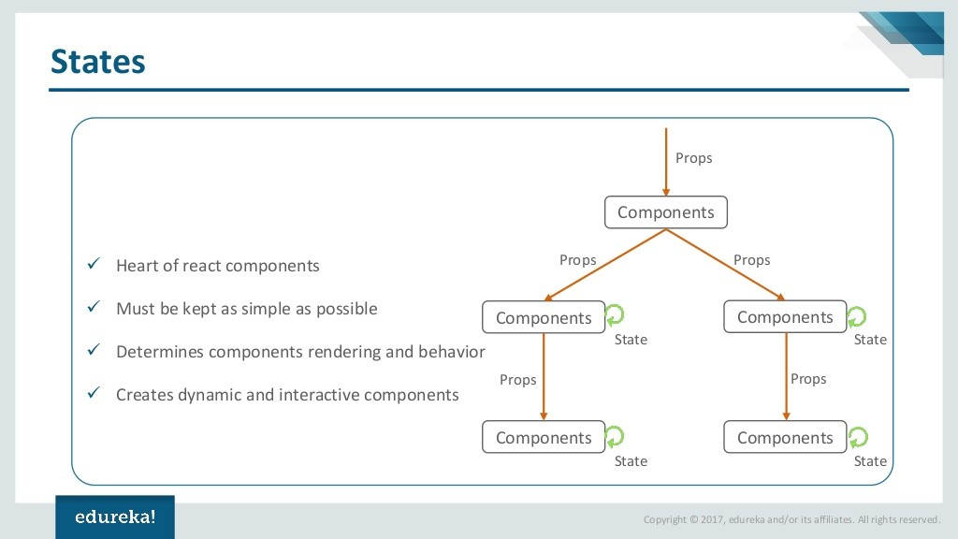

Slide 49
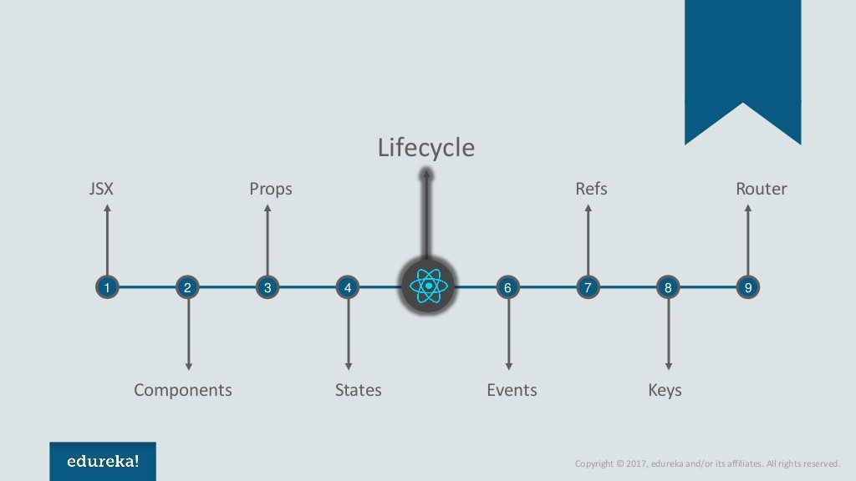

Slide 50
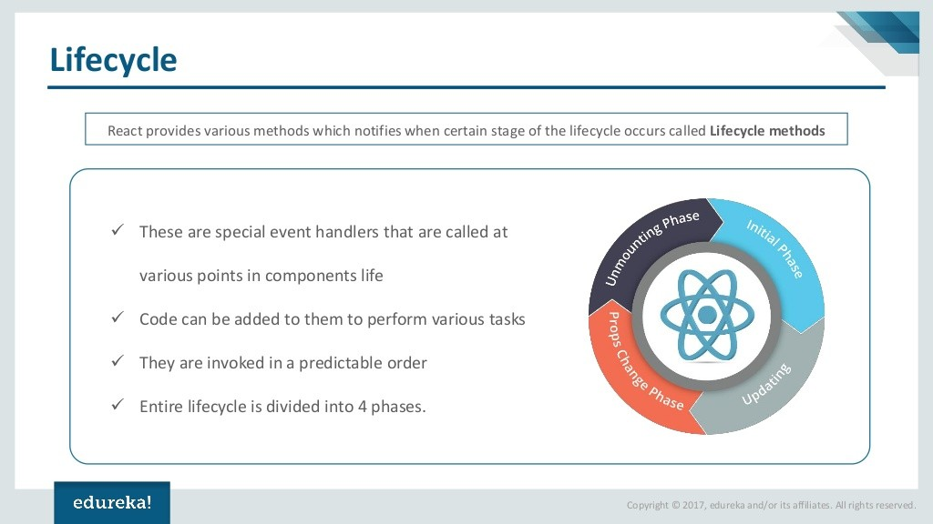

Slide 51
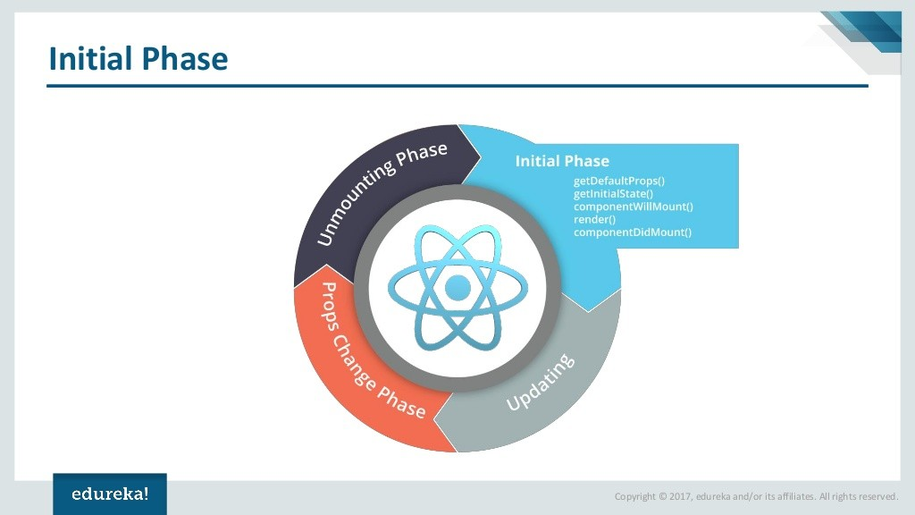

Slide 52
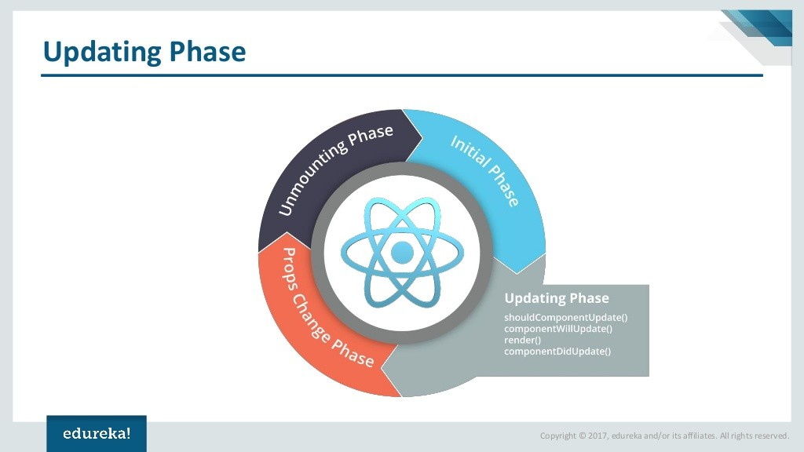

Slide 53
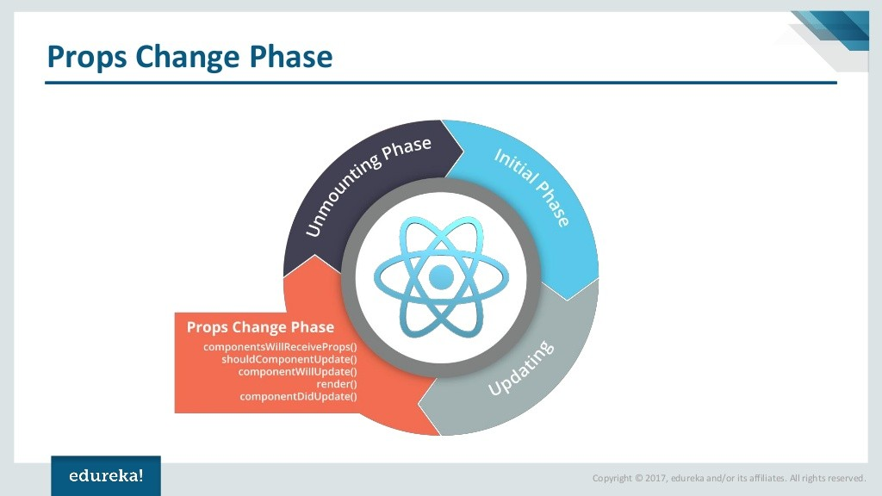

Slide 54


Slide 55


Slide 56


Slide 57


Slide 58


Slide 59


Slide 60


Slide 61


Slide 62


Slide 63


Slide 64


Slide 65


Slide 66


Slide 67


Slide 68


Slide 69


Slide 70
React Component Life cycle

Slide 71
React enables to create components by invoking the React.createClass() method which expects a render method and triggers a lifecycle that can be hooked into via a number of so called lifecycle methods.

Slide 72
The Lifecycle
To get a clear idea of the lifecycle we will need to differentiate between the initial creation phase, where the component is created, and state and props changes triggered updates as well as the component unmoutings phase.

Slide 73
Initialization

Slide 74
State Changes

Slide 75
Props Changes

Slide 76
Redux

Slide 77
Redux
A Redux is a predictable state container for JavaScript apps.

Slide 78
Three Principles
The state of your whole application is stored in an object tree within a single store.
This makes it easy to create universal apps, as the state from your server can be serialized and hydrated into the client with no extra coding effort. A single state tree also makes it easier to debug or introspect an application; it also enables you to persist your app's state in development, for a faster development cycle.

Slide 79
State is read-only
The only way to change the state is to emit an action, an object describing what happened.

Slide 80
Changes are made with pure functions
To specify how the state tree is transformed by actions, you write pure reducers.
Reducers are just pure functions that take the previous state and an action, and return the next state. Remember to return new state objects, instead of mutating the previous state. You can start with a single reducer, and as your app grows, split it off into smaller reducers that manage specific parts of the state tree. Because reducers are just functions, you can control the order in which they are called, pass additional data, or even make reusable reducers for common tasks such as pagination.

Slide 81


Slide 82


Slide 83


Slide 84


Slide 85


Slide 86


Slide 87
What was wrong with the original MVC frameworks?
Originally, there were many MVC frameworks out there of different sizes and shapes, but generally can be either categorized as MVCs or an extension of MVC. Flux/Redux attempts to resolve the problem where bugs are difficult to trace when a model has been continuously updated as an app is being used.

Slide 88


Slide 89
The problem with this is when there are many views and models and one of the model’s state changed into something we didn’t expect, we are unable to efficiently trace which view or which model caused the problem, since there are way too many possibilities.

Slide 90
How does Redux Work?
Redux can be broken down into the following:
– store: manages the states. Mainly there is a dispatch method to dispatch an action. In a Redux app, you can obtain its states via store.getState()
– action: a simple, plain JavaScript object. An action can also be considered as a command to change a state.
– reducer: decides how to change a state after receiving an action, and thus can be considered the entrance of a state change. A reducer is comprised of functions, and it changes states by taking an action as an argument, in which it then returns a new state.
– middleware: the middleman between a store.dispatch() and a reducer. Its purpose is to intercept an action that has been dispatched, and modify or even cancel the action before it reaches the reducer.

Slide 91


Slide 92

In a more complex app, we will need to split up a store’s state into different pieces like we’d do when namespacing. You can do this in Redux by creating different reducers to manage different areas of a state, and then merge them together through combineReducers.

Slide 93
Async & Middleware
We’ve already introduced state updating, but a front-end app is never that simple
Here we’ll go over how to handle asynchronous behavior in a Redux app. In this section, we’ll examine the process of sending an HTTP request to understand how async works in Redux.

Slide 94
The Sample Situation
Let’s say we have an app that a list called questions. At some point (e.g. a user clicks a button), we will need to send a request to our server to obtain the data in questions. While sending this request, we need to reflect the sending state in our store, and if the request has been made successfully, we will need to put the data of questions in our store. If the HTTP request failed, we will need to reflect the failure info in our store.

Slide 95

What is a Middleware?
in Redux a middleware is like the negotiator between store.dispatch and reducer. To be more specific, the store.dispatch() we call is actually comprised of layers of middleware, and the reducer is in the innermost layer.

Slide 96
Through a middleware, we can extract the above-mentioned asynchronous API request and place them in the same middleware. In other words, when sending an API request, we will need to dispatch an action of a specific type, and then let our middleware intercept such types of actions to send the respective API request.
The middleware will intercept any action with the CALL_API key, and then send an API request based on the method, path, query, successType, etc stored inside the action.
This way, when we really need to send a request, we won’t have to deal with asynchronous logic and we’ll only need to dispatch an action that has CALL_API.

